Slide 1
JOE APPLETON

Slide 2
Why Conduct A Literature Review?
Notes:
Lessens the affect of a individual paper (Andrew Wakefield was struck off after his anti-MMR 'science )
Placed your work against a backdrop of wider studies

Slide 3
“A cornerstone of science is the possibility to critically assess the correctness of scientific claims made and conclusions drawn by other scientists.” (Plesser 2017, p. 1)

Slide 4

Different Types of Literature Reviews
A Narrative Review
A Meta Analysis
A Systematic Review

Slide 5
Tt
Perils of ‘cherry picking’ literature
User Feedback
Benchmarking
Notes:
However, the arguments presented in the book were challenged some years later by Knipschild (1994) among others, who undertook a systematic review of all the evidence surrounding the effectiveness of vitamin C and came to very different conclusions.

Slide 6
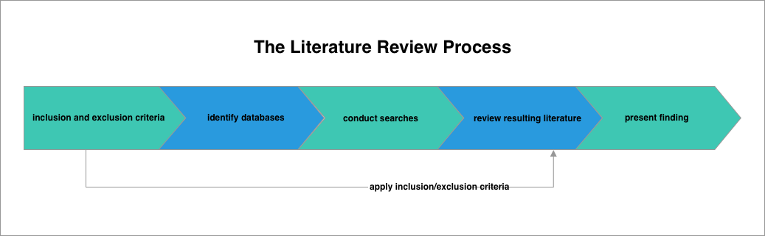
We can avoid cherry picking through a systematic review
User Feedback

